Slide 1

Curriculum Workshop for Parents
Hazel Class
September 2024

Slide 2
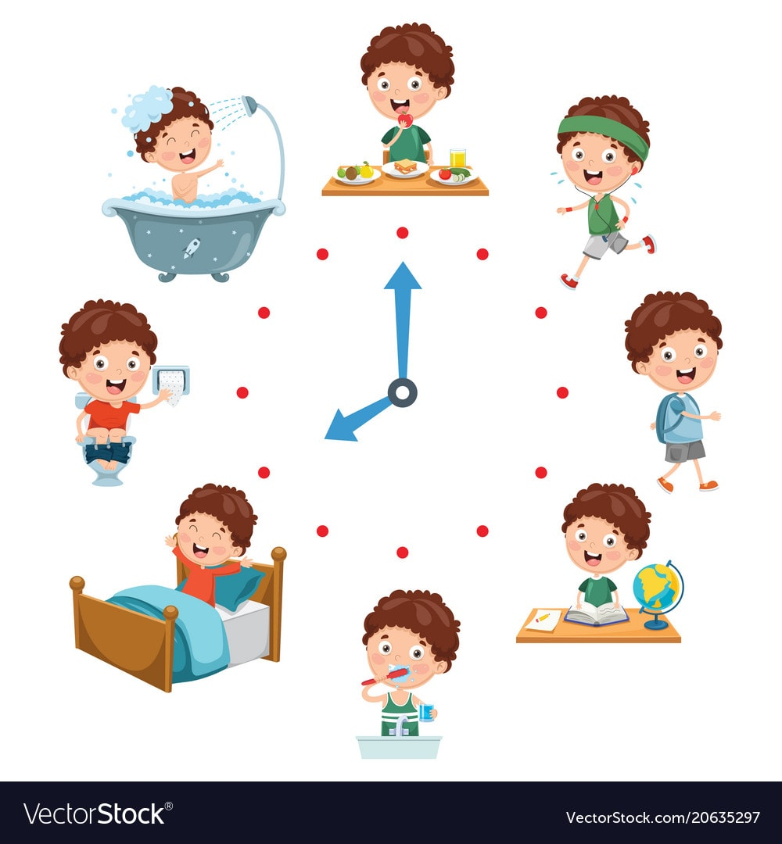
Class routine
Structure of day
  Good morning task – promote independence
  Guided Reading session
  Maths
  English
  Afternoons – range of foundation subjects
  PE session with WLSP Monday and Thursday
  Collective Worship and assemblies

Slide 3

Homework
Routine
  Week to complete – Uploaded on a Wednesday and checked by staff on Tuesday.
Expectations
  Reinforcing work covered in class – reinforcing basic skills of maths and English
  Expect all children to complete good reinforcement of what they have learnt in school
  Spellings. Week to practise at home.
Showbie – all posted on Showbie with children posting work back to mark
If children bring in homework to a member of staff, please can you write a message in Showbie to let us know it has been completed.
Daily reading – raffle tickets and challenges
Expectation that all children read at least 4 times a week

Slide 4
Spelling
Focus now is on spelling rules and patterns
Teaching lesson – Monday
Sessions through the week to practise the spellings using range of methods including No Nonsense Strategies
Children need to practise at home
Spellings are in bags – sheets taken home
Test in small blue books and sent home so parents can see the score. Must be returned sometime in the week before the next test.

Slide 5

Reading
“Promote love of reading and for all children to be readers”
Library visits
Class novel
Writing is book based
Quiet reading
Reading at home
Extra reading activities – reading buddies and curl up with a book
We aim to read with the children in school a few times a week
Reading at home
Some children may have a phonics based reading book.
Children are on a colour banded book linked to their level of reading development

Slide 6
Guided Reading
“Promote love of reading and for all children to be readers”
Teacher models excellent reading
All children follow the text and listen
Vocabulary discussed each day – promote learning new words and their meaning
Small tasks given – promote independent work but a wide range of methods using – scaffolded for those that need it.
Book for this half term is “Fantastic Mr Fox”

Slide 7

Writing
I’m a Clever Writer approach
  Based around a book
  Exploring the text and looking at vocabulary
  Success criteria to support writing working towards independent work
  I’m a clever writer because I can…
Importance of handwriting and spellings / link with phonics
Promotion of neatly presented work which we are proud of
Grammar vocabulary
Star Write books – something to be proud of

Slide 8

Maths
White Rose Scheme – small steps: concrete – pictorial – abstract
Teaching input matches children’s work
Work becomes progressively harder and applied knowledge to problem solving
Next day builds up previous knowledge
Flashback used to recap previous knowledge from
previous years and lessons
Focus on place value – root of all maths
Multiplication Tables - recall and use 2, 5 and 10 times tables by the end of the year – must understand what it means – Y2
Y3 tables – 3, 4, 6
Methods and jottings for maths – from policy that is on the website
Practical work
Vocabulary

Slide 9

Learning More, Remembering More
Cognitive Overload – how curriculum is taught with revisiting of previously taught knowledge – linking learning together.
Knowledge Journals - collect knowledge and remember knowledge
Focus on vocabulary for all subjects

Slide 10

Formal Assessments
Y2 teacher assessments in reading, writing and maths for end of KS1
Focus: children don’t really know and we manage them discretely in school
Ongoing assessments throughout all lessons

Slide 11

Keeping safe online
Covered within lessons and assemblies using child taught across the school every term using stories and activities.
Handout for parents
  Online Content – 10 tips to keep you children safe online

Slide 12

Keeping in touch
Newsletter, monthly calendar and Facebook
Email class
Catch us at the end of the day
Termly opportunities – parents evening
Termly Family Morning/Afternoon - dates on website
Class page on website – just being updated - has curriculum information

Slide 13
Thank you for attending.
We really appreciate your support.

