Slide 1

Curriculum Workshop for Parents
Beech Class
September 2026

Slide 2
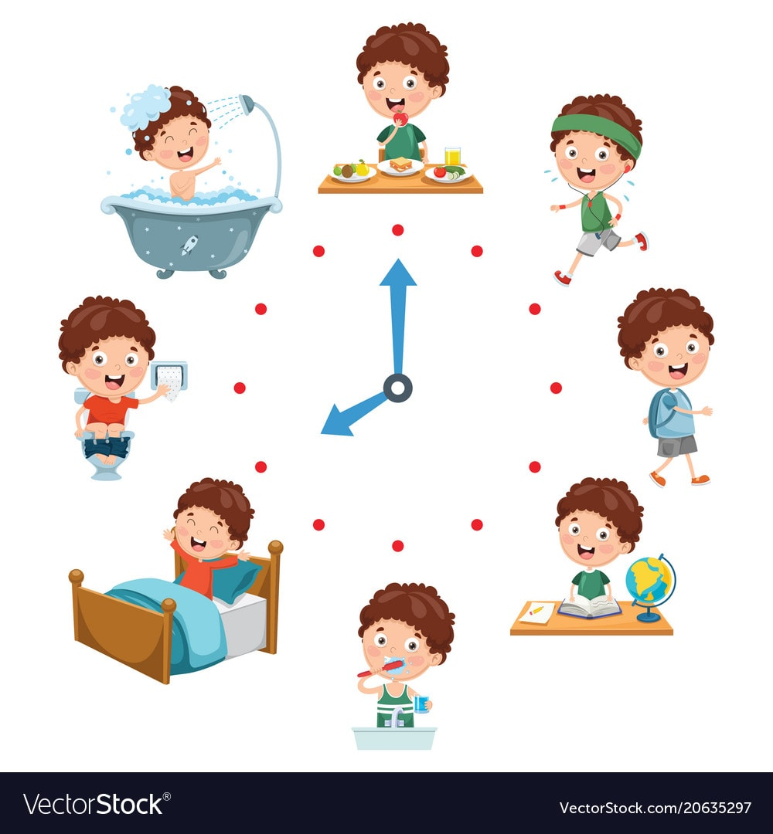
Class routine
Structure of day
  Morning task – promote independence & a calm start to the day
  Phonics sessions for both Reception & Year 1
  English
  Maths
  Afternoons – range of foundation subjects
  PE session with WLSP Tuesday & Thursday
  Collective Worship and assemblies

Slide 3
Reading
  Phonics reading books sent home every Friday
  Flash cards and words to practice sent home every Friday
  Please hear your child read at home
  Please fill in a comment in the yellow reading record
  We will hear your child read in school throughout the week
  Reading helpers coming into school

Slide 4
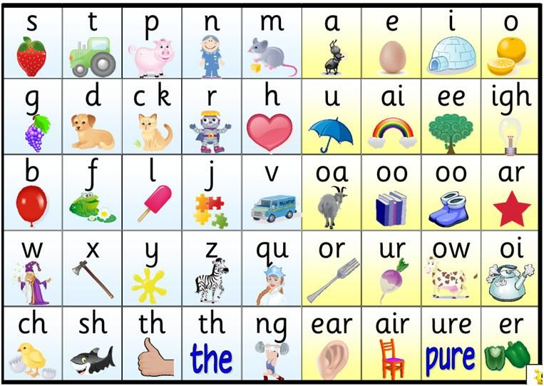
Phonics –Beech Class
Phonics scheme is called “Red Rose”
Delivered to whole year group
Year 1 and Reception are taught separately
Reviews sounds learnt previously
New grapheme is taught every day, tricky words etc
Combines continuous and reactive assessment
Supports lower attainers
Children keep up rather than catch up
Provides immediate, in the lesson, intervention
Supports reading
Reading books sent home to support the phonics throughout the week

Slide 5

Writing
I’m a Clever Writer approach
  Based around a book
  Exploring the text and looking at vocabulary
  Success criteria to support writing working towards independent work
  I’m a clever writer because I can…
Importance of handwriting, phonics and spelling
Promotion of neatly presented work which we are proud of
Lots of activities to support Reception children's fine motor control
Hand writer Award in Celebration Assembly

Slide 6

Maths
White Rose Scheme – small steps: concrete – pictorial – abstract
Teaching input matches children’s work
Work becomes progressively harder and lots of problem solving
Next day builds up previous knowledge
Flashback used to recap previous knowledge from previous years and lessons
Practical work
Vocabulary
Year 1 children complete their pages of their White Rose Maths book
Reception complete Maths Activities outdoors and within provision . For example; Going on a number hunt

Slide 7

Formal Assessments
Y1 Phonics Assessment June
Teacher assessments in reading, writing and maths
Early Years assessments
Ongoing assessments throughout all lessons

Slide 8

Keeping safe online
Covered within lessons and assemblies every term
Handout for parents

Slide 9

Keeping in touch
Facebook
Weekly newsletter
Dojo message
Catch us at the start of the day
Catch us at the end of the day
Termly opportunities – parents evening
Family Morning/Afternoon
Class page on website – just being updated - has curriculum information

Slide 10
Thank you for attending.
We really appreciate your support.

