Slide 1

Curriculum Workshop for Parents
September 2026

Slide 2

Welcome to Year 5 and 6
Our weekly timetable:
  Daily morning work – learn spellings/quiet reading/ practise tables
  Guided reading
  English
  Maths
  Spellings, Handwriting
  PSHE
  Swimming (Autumn Term)
  Afternoons – foundation subjects – broad and balanced curriculum

Slide 3
Year 5 and 6 Expectations
Independence with belongings
Independence and responsibility with letters especially sport communications
8:50-9:05 daily morning work
Excellence in behaviour linked to school values and leading by example
Remembering belongings – reading book, homework
Remembering to complete homework on time
Focus on handwriting and presentation

Slide 4

Focus on reading
Reading – help us give our children “super powers”
  Impact on vocabulary
  Impact on knowledge
  Developing the whole child
  Impact on writing
  Expectations – reading challenges;
  reading at home; Y6 books with correct level of vocab;
  recommended books
Focus on wide selection of books
Reading for sustained periods of time
Reading aloud with expression and fluency
Daily guided reading – inference, analysis of author’s choice of words etc, comprehension, retrieval.

Slide 5

English
Handwriting and Presentation
Focus on spelling
Grammar terms and knowledge
I Am a Clever Writer
  Structure
  Success Criteria
  Progressive each term to help prevent cognitive overload
  Range of types of writing
  Links grammar with writing
  Star Write
  Basics must be correct – high priority
This Photo by Unknown Author is licensed under CC BY-SA

Slide 6
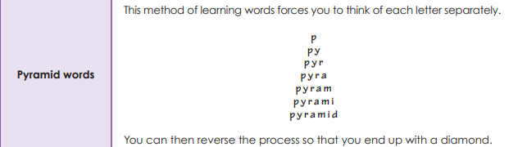
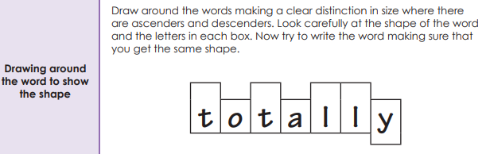
Spellings –No Nonsense Spellings

Slide 7
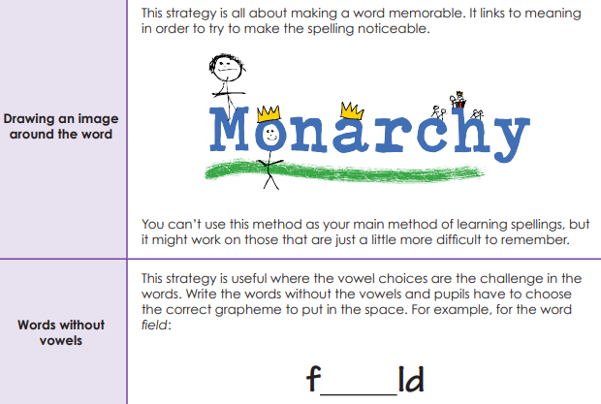

Slide 8

Maths – mastering number
White Rose Scheme – small steps; concrete – pictorial – abstract
Teaching input matches children’s work
Work becomes progressively harder and applies knowledge to problem solving
Next day builds on previous small step
Flashback
  Multiplication tables
  Weekly homework
  LBQ
  End of year expectations

Slide 9
Homework in Oak Class
Daily reading
Spellings – Monday test
Multiplication tables/Arithmetic quiz
Homework: Handed out on Tuesdays
Year 6 - 3 elements: Maths; English and Grammar, spelling revision - due Monday
Year 5 - 2 elements: Maths or English and grammar, spelling revision - due Monday
Creative work - termly
Y6 increase in homework towards SATS. SATs club after school starts in January for specific revision and practice.

Slide 10
Ways to support parents
Online Safety – guide and how we teach it in school
SATS meeting early Spring Term for Y6
Written calculation policy and small steps for maths on website
Recommended reads

Slide 11
Working together with parents
Email – head@richarddurnings.lancs.sch.uk
Daily contact face to face or via Class Dojo
Sooner rather than later!
Parents Evening – face to face. Look at children’s books.
Class page on website curriculum content etc – to be updated with new website!
Y6 SATS meeting early Spring Term
Any questions?
Thank you so much for coming today.

