Slide 1
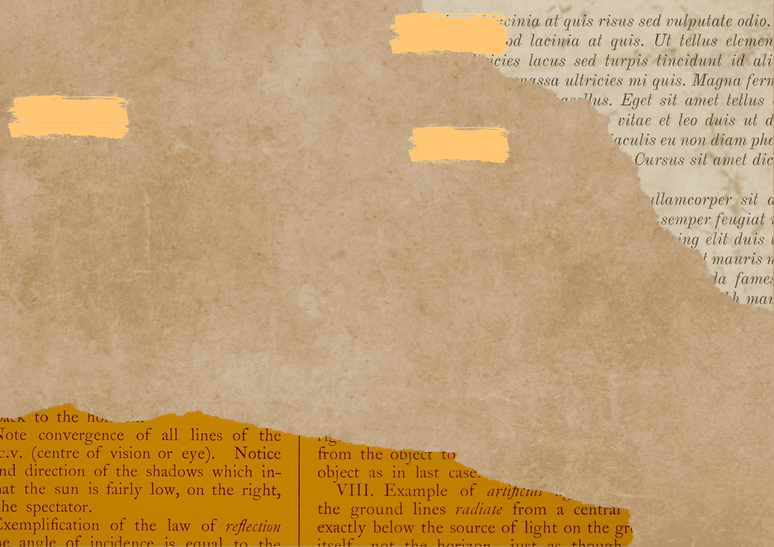
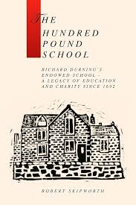
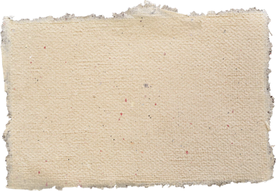
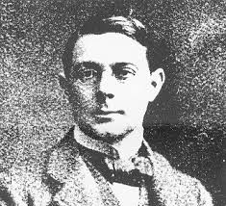
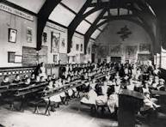
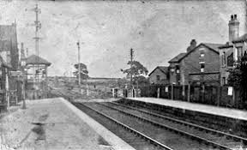
Local History:Richard Durning's- How has time changed Richard Durning's School?
Sticky Knowledge
Useful Books/photographs
When?
Richard Durning's School was built in 1692
Key Vocabulary
How was the school built?
The school was built from £100 left in a will from Richard Durning
Who was Richard Durning?
Richard Durning was born in 1616
He was a yeoman farmer
He lived in Brandreth House and married Margaret Wainwright
Vocabulary | Definition
history | Series of past events
Significant | Important/ great, leading to change
past | Having happened or gone by at an earlier time
present | Happening now, in this time
charity | An organization set up to give help and raise money
sequence | A particular order in which things follow each other
timeline | A chronological arrangement of events in the order of their occurrence
Victorian | A person that lived during the Victorian period
will | Allows you to decide what happens with your money, property & assets when you die
Victorian period
Schools were strict
Days were long
Boys & girls played in separate playgrounds
The main subjects were Reading, Writing & Arithmetic
How do we find out about the past?
reading books
internet
talking to people who were around at the time
museums
video clips
Newspaper clips
photographs
looking at objects

Slide 2

…?
…?
Key Question
Key Vocabulary
Useful Books...
Vocabulary | Definition

