Slide 1
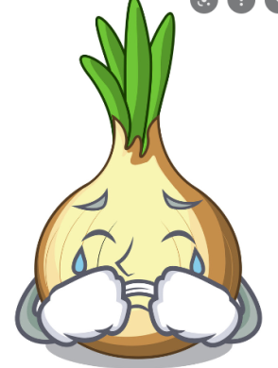
Why do we cry when we chop onions?

Slide 2
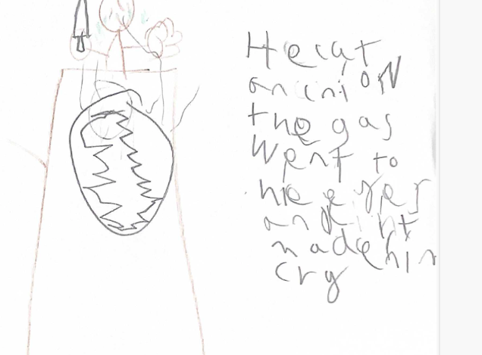
Joel - ‘He cut an onion and the gas went to his eye and made him cry.’

Slide 3
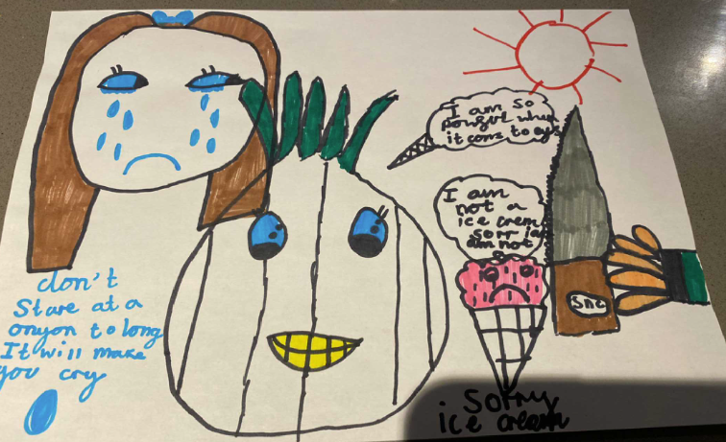
Cora

Slide 4
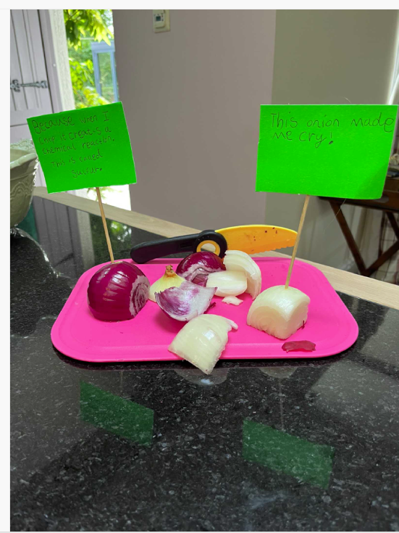
Sienna loved this experiment. It made her cry!

Slide 5
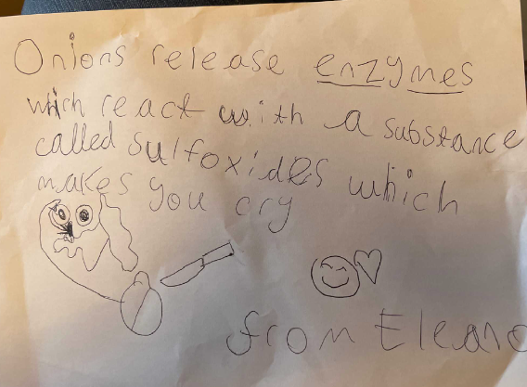
Eleanor

Slide 6
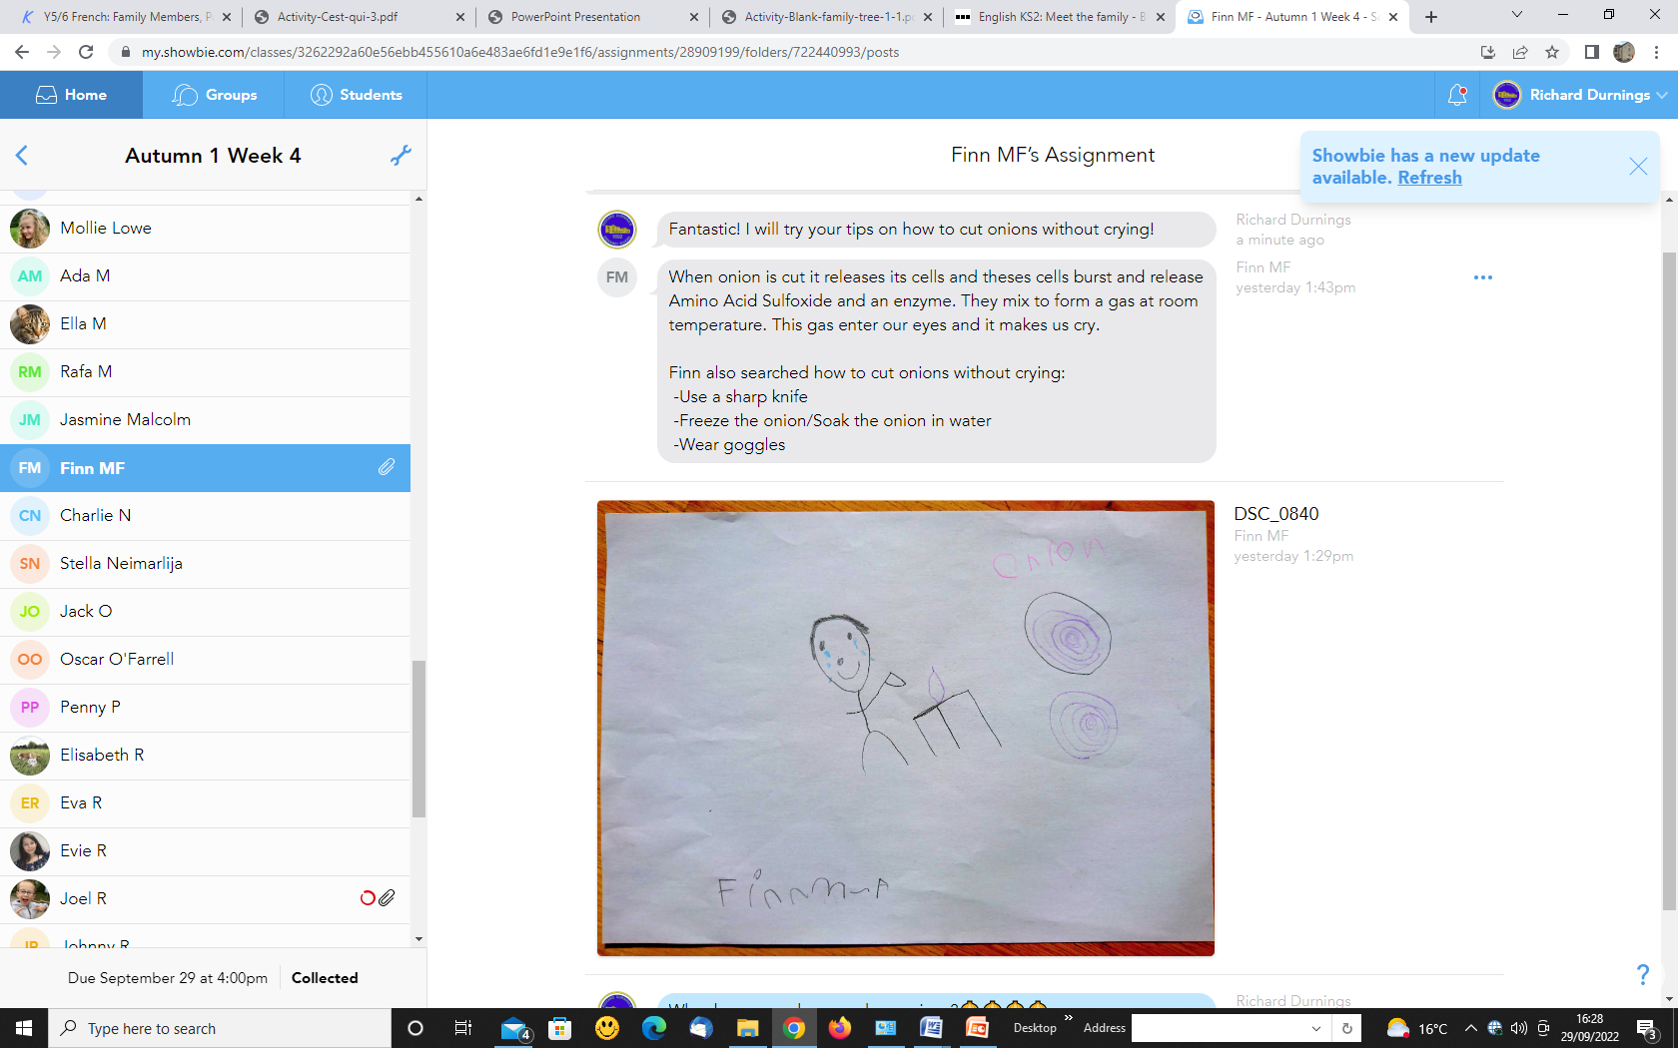
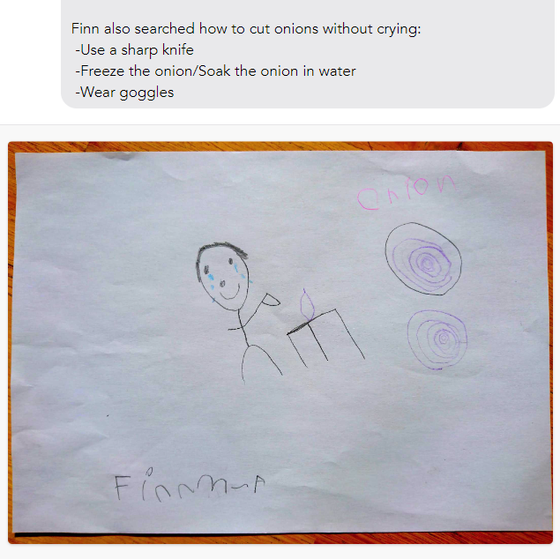
Finn

Slide 7
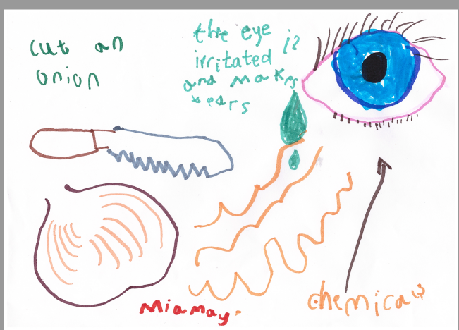
Mia

