Slide 1
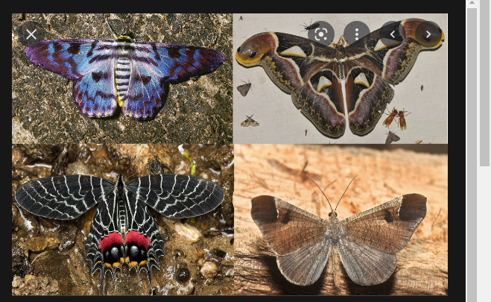
What is the difference between a moth and a butterfly?

Slide 2
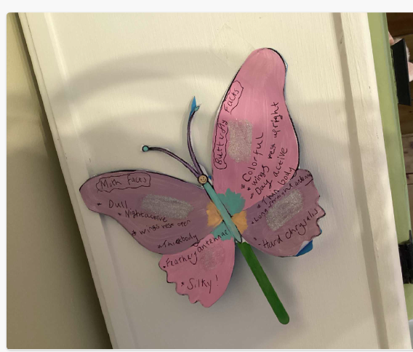
Sienna’s beautiful butterfly

Slide 3
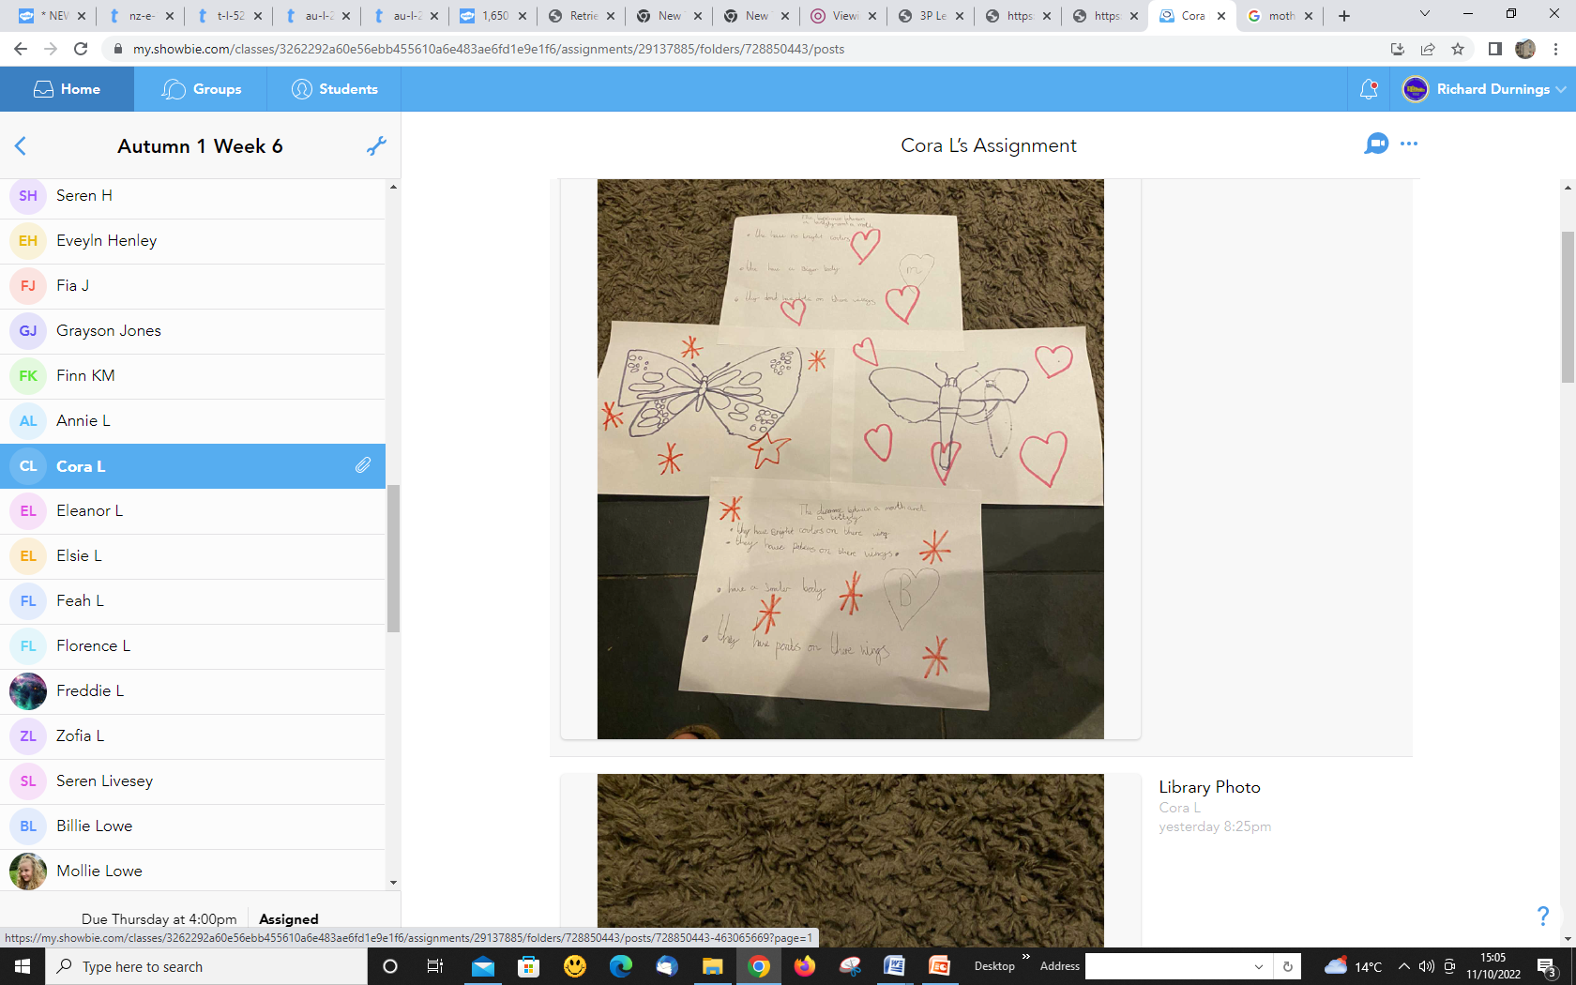
Cora’s brilliant observations.

Slide 4
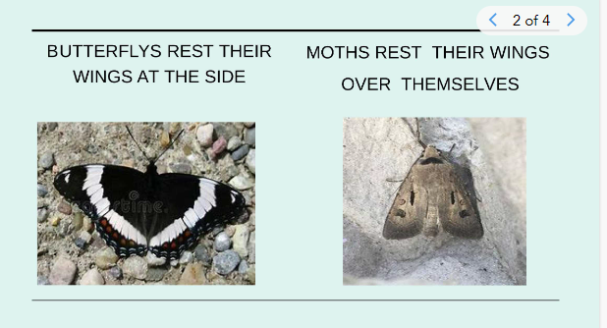
Evie R made a slideshow with some interesting facts.

