Slide 1
This week Sienna asked
What is Evolution?

Slide 2
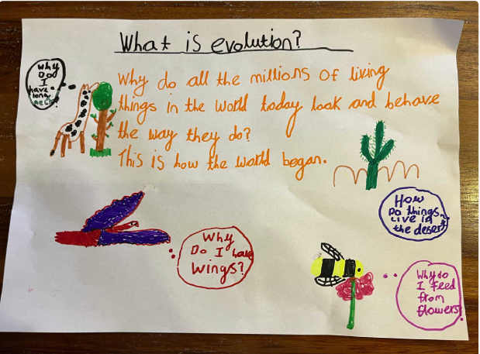
Sienna

Slide 3
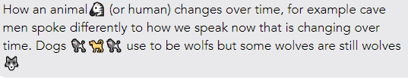
Holly’s answer
Year 4

Slide 4
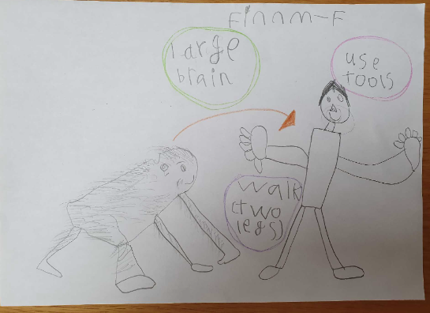
Finn

Slide 5

Charlie
Year 3

