Slide 1
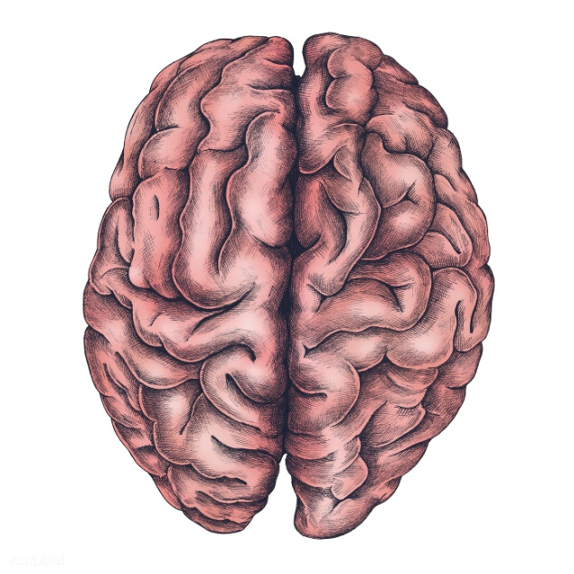
What do the different sides of our brain control?

Slide 2
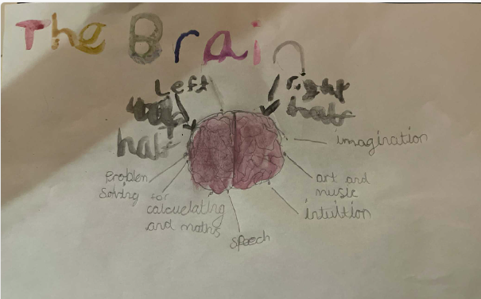
Eleanor

Slide 3
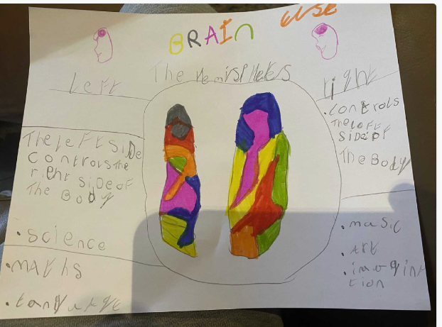
Elsie

Slide 4
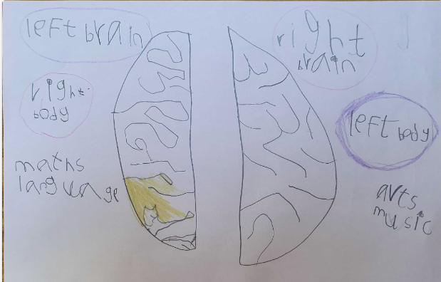
Finn

Slide 5


