Slide 1
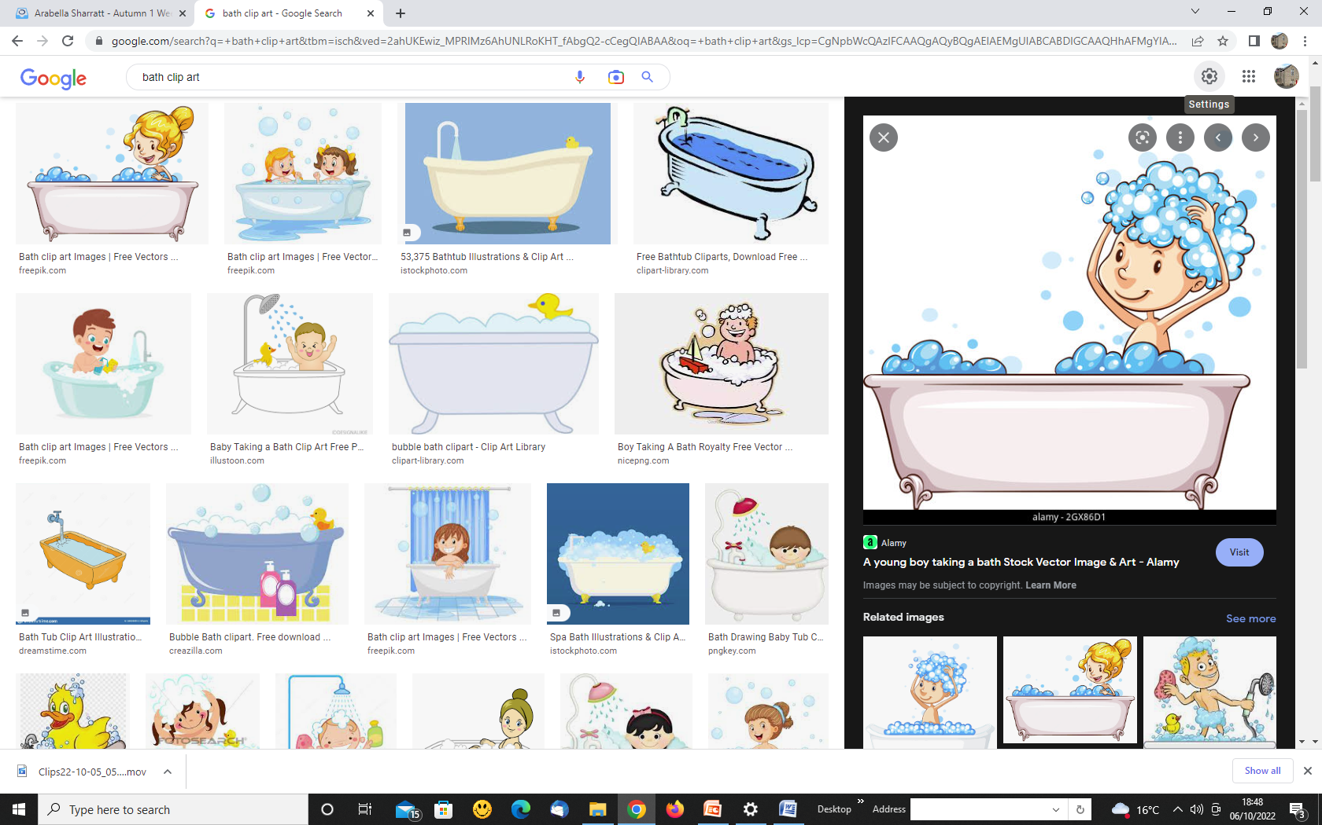
Why do your fingers and toes become wrinkled in the bath?

Slide 2
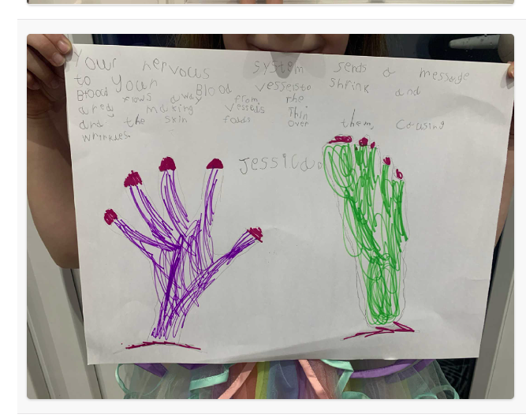

Slide 3
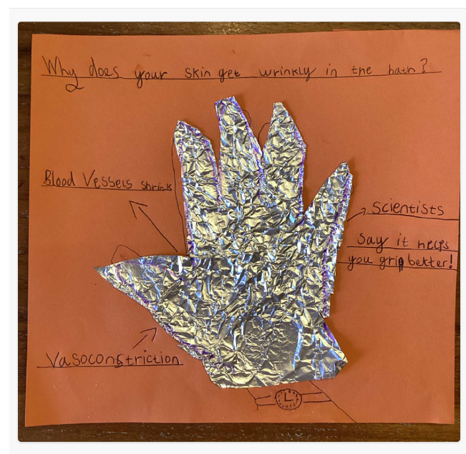
Sienna our super scientist has learnt what vasoconstriction means

Slide 4
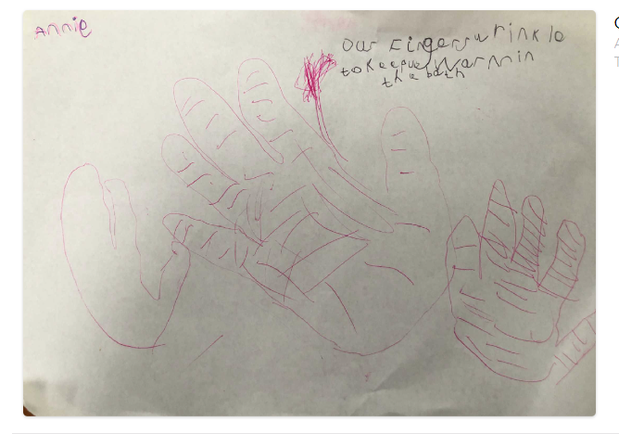
Annie

Slide 5
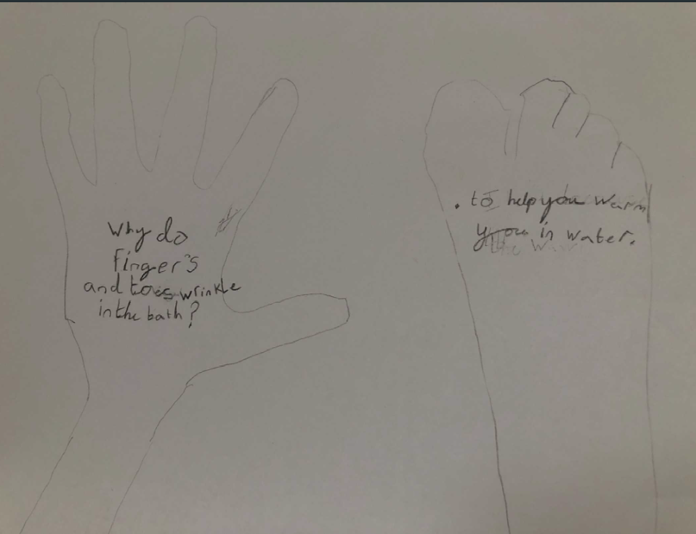
Florence

Slide 6
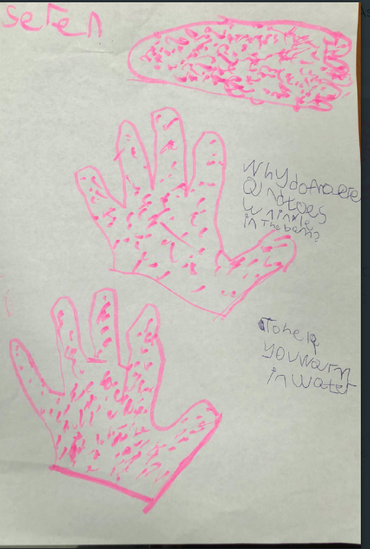
Seren

Slide 7
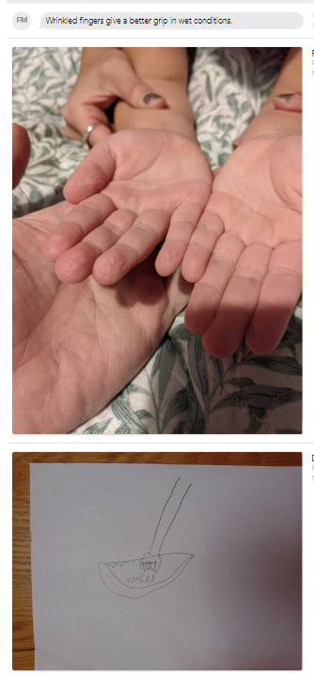
Finn -
Wrinkled fingers give a better grip in wet conditions.

