Slide 1

Eleanor’s question is why do we have skin?

Slide 2


Amelia
Feah
Elsie

Slide 3
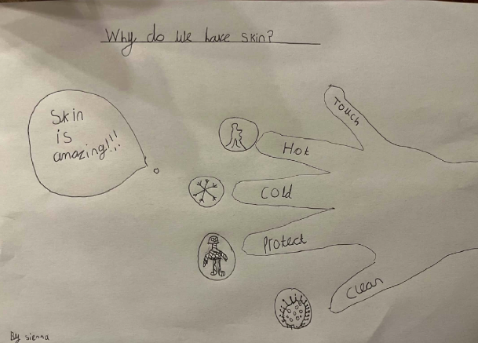
Sienna

Slide 4
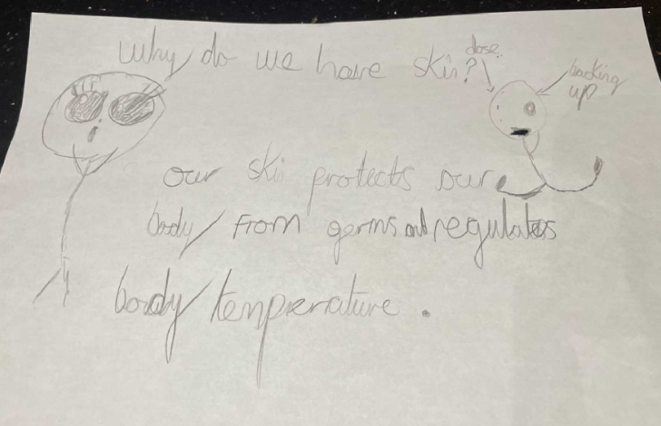
Eleanor

Slide 5
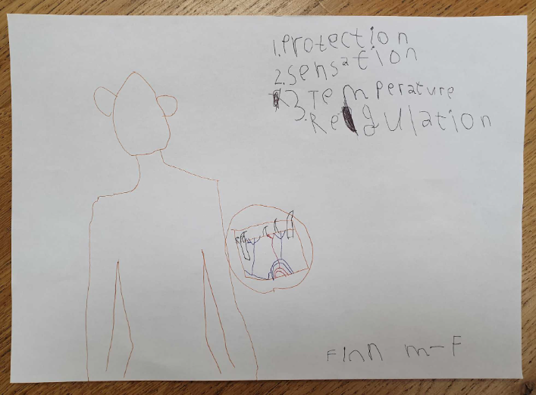
Finn

