Slide 1
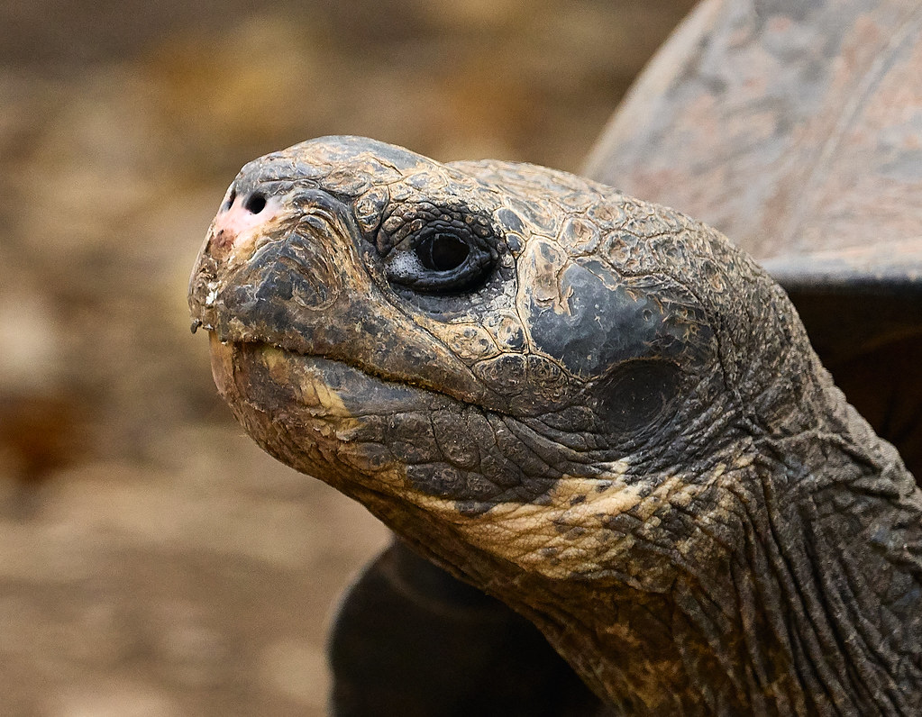
Question from Feah L
Why do turtles move so slowly?

Slide 2
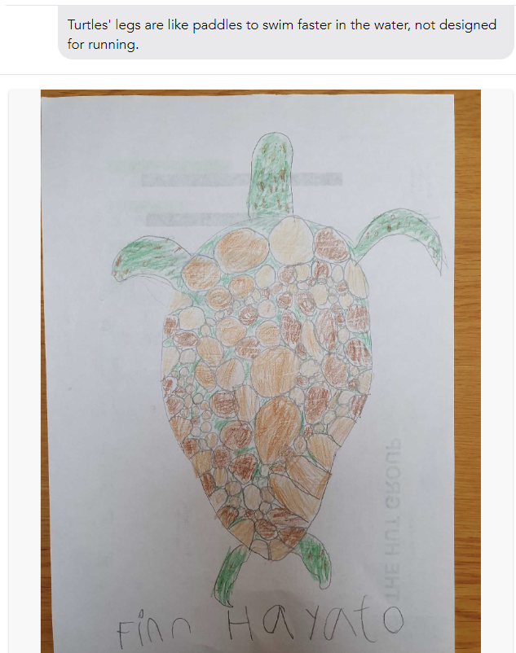
Finn MF

Slide 3


