Slide 1
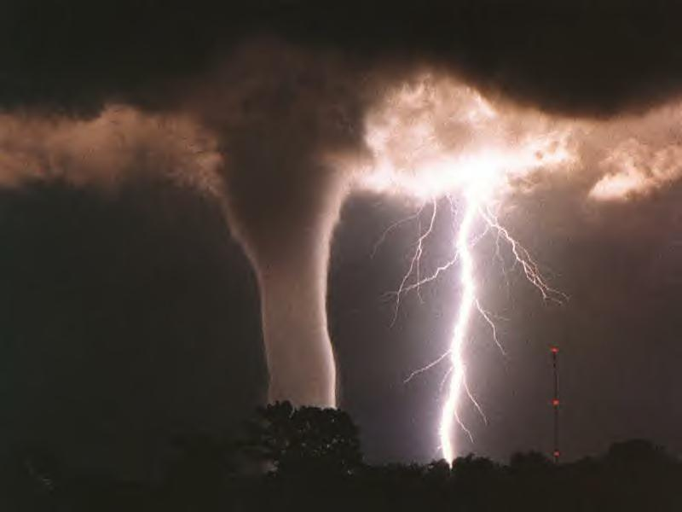
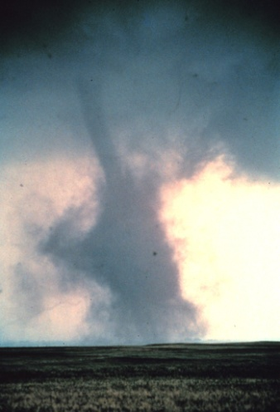
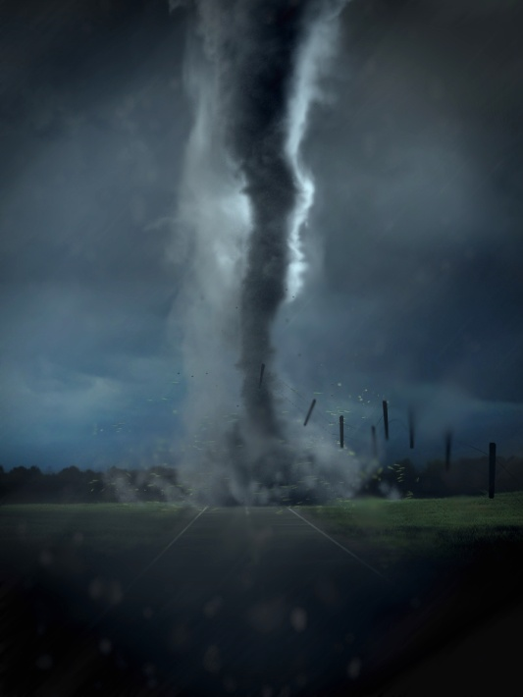
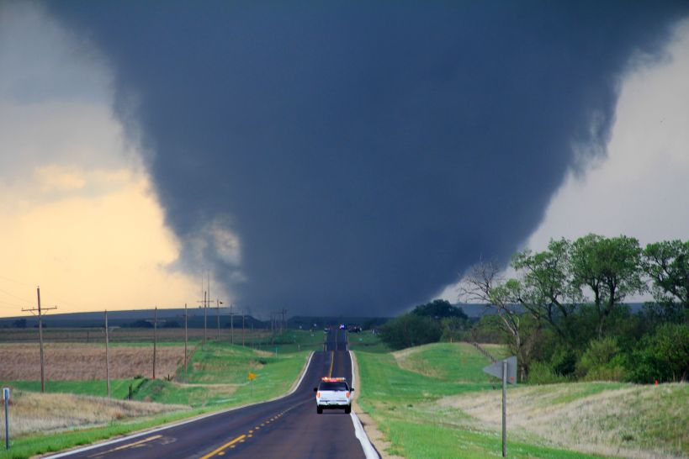
How do tornadoes start?
(Elsie’s question)

Slide 2
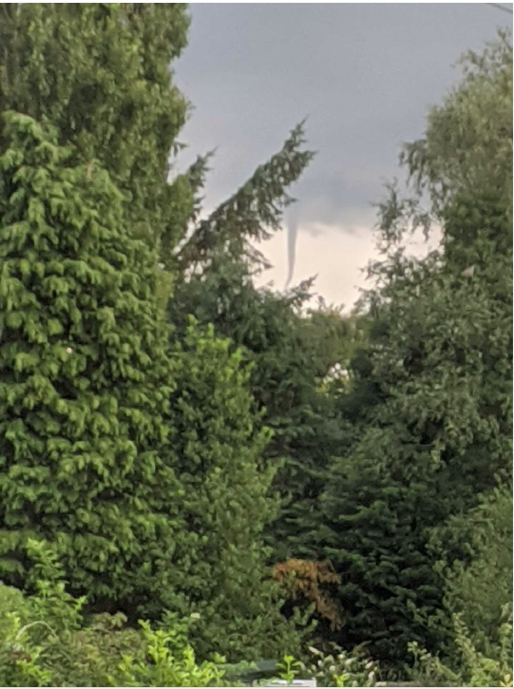
This is a tornado that Finn MF spotted in Hilldale in 2020

Slide 3
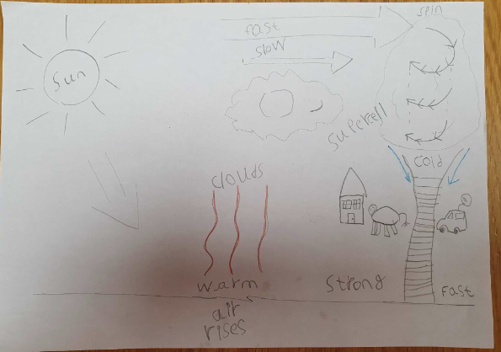

Finn’s poster and Feah L’s explanation.

