Slide 1

Year 1 Phonics Screening Check – Will be in June 2025
Information for Parents

Slide 2
What is the Phonics Screening Check?
• A short, statutory assessment for Year 1 pupils.
• Designed to check if children can decode words using phonics skills.
• Conducted in June 2025 in schools across England.

Slide 3
Why is it Important?
• Identifies children who need extra phonics support.
• Helps teachers plan next steps in learning.
• Ensures early reading & phonics skills are on track.

Slide 4
How Does it Work?
• One-to-one with a teacher.
• 40 words to read – mix of real and 'pseudo' (nonsense) words (share sample test)
*Similar to the tests the children have had sent home to go through
• Uses phonics skills to sound out words.
• Takes around 5-10 minutes.

Slide 5
How Can Parents Help?
• Practice phonics regularly at home.
• Read with your child daily – books, signs, labels.
*Go over homework sent home
• Play phonics games and use online resources.
www.phonicsplay.co.uk
• Encourage segmenting and blending of sounds.
• Stay positive and make reading fun!

Slide 6
What Happens After the Check?
• Results shared with parents.
• Children who do not meet the expected standard receive extra support.
• Retake in Year 2 if needed.

Slide 7
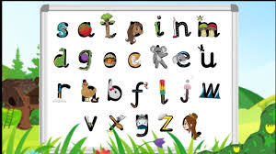
Questions?
Please speak to me if you have any questions or concerns.

