Slide 1


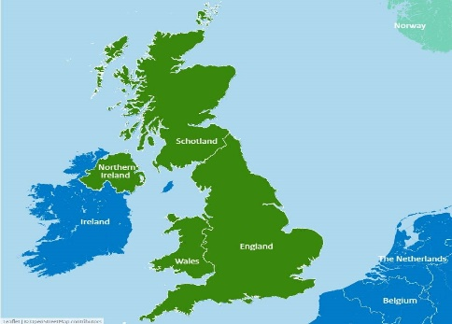


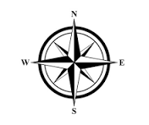
Map & Field Work
Useful Books...
Sticky Knowledge
Key Vocabulary
I know the four countries of the UK
England
Scotland
Northern Ireland
Wales
I know the four points of a compass and how to apply this to a map
North
East
South
West
Vocabulary | Definition
Location | A particular place or position
Position | Location of an object
Human Features | Something that has been built or made by humans
Physical Features | Natural characteristics of a place. For Example; mountains, rivers, valleys, oceans
Map | A drawing that represents a place
Symbols | Small pictures that stand for different features on a map
Compass | Tells us which way is north, south, east & west
Country | A distinct part of the world
Town | A place where people live
Village | A group of houses or buildings smaller than a town
Sticky Skills
Use a world map to identify the UK and its countries
Use simple compass directions and locational and directional language
Identify human and physical features of the surrounding environment

Slide 2



Title
Key Question
Sticky Knowledge
Sticky Skills
Useful Books...
Vocabulary | Definition
Key Vocabulary
Info...
Info...

Slide 3


