Slide 1

Curriculum Workshop for Parents
Beech Class
September 2024

Slide 2
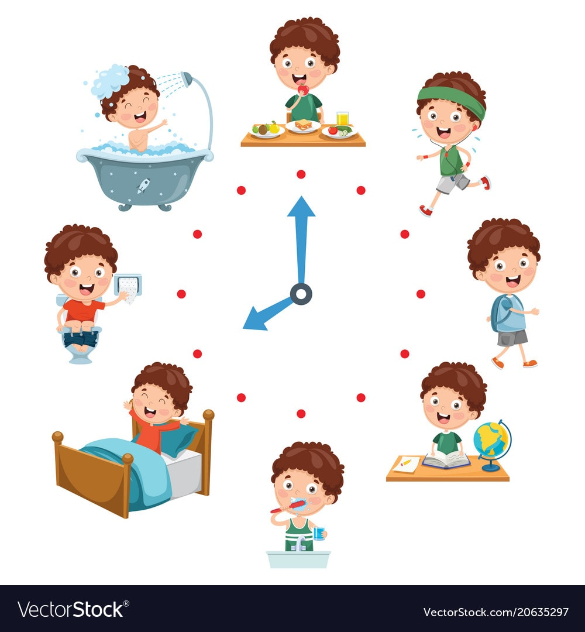
Class routine
Structure of day
  Putting coats & bags on pegs – promote independence
  Phonics session
  Maths
  English
  Afternoons – range of foundation subjects
  PE session with WLSP Monday & Thursday
  Collective Worship and assemblies

Slide 3

Homework Year 1
Routine
  Will start week 2
  Week to complete – May be in Showbie or in folder and to bee handed in the following Tuesday
Expectations
  Reinforcing work covered in class – reinforcing basic skills of maths and English
  Expect all children to complete good reinforcement of what they have learnt in school
  Spellings have been set in green books. Week to practise at home and then have a spelling quiz in class.

Slide 4
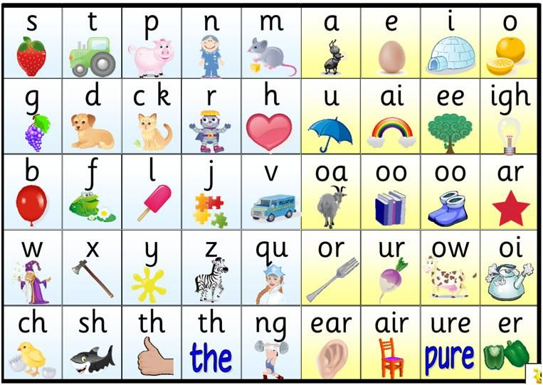
Phonics – Beech Class
Phonics scheme is called “Essential Letters and Sounds”
Delivered to Reception/ Year 1 in separate sessions
Reviews the sounds learnt previously
New grapheme is taught every day – see chart & sheets to take away
Combines continuous and reactive assessment
Supports lower attainers
Interventions started early
Supports reading
Activity book to complete each day

Slide 5

Reading
“Promote love of reading and for all children to be readers”
Library visits
Class story books
Writing is book based. For example; Three Little Pigs recent writing
Quiet reading
Reading at home
Extra reading activities – reading buddies and curl up with a book on a Friday
We aim to read with the children in school a few times a week
Volunteers come in each week to hear readers
Reading at home
All children will have a phonics reading book linked to the sounds they have been taught that week.
Main priority is for the children is to read their phonics book numerous times over the week. This needs to be daily. These will come out Monday/ Tuesday and will be changed the following week
Please write in yellow reading record book
Reading challenges at the front of the yellow reading record

Slide 6

Writing/ Mark making
I’m a Clever Writer approach
  Based around a book
  Retelling the story and looking at vocabulary
  Role-play, writing area for Reception, forming letters then words
  Success criteria to support writing working towards independent work
  I’m a clever writer because I can…
Importance of handwriting and spellings / link with phonics
Promotion of neatly presented work which we are proud of
Hand writer of the week award
Hand out for writing for Year 1

Slide 7

Maths
White Rose Scheme for Year 1
Mastery in Maths for Reception
Teaching input matches children’s work
Work becomes progressively harder and applied knowledge to problem solving
Next day builds up previous knowledge
Flashback used to recap previous knowledge from previous years and lessons
Maths games / outdoor hunts
Practical work
Vocabulary

Slide 8

Learning More, Remembering More
Cognitive Overload – how curriculum is taught with revisiting of previously taught knowledge – linking learning together.
Knowledge Journals -collect knowledge and remember knowledge
Focus on vocabulary for all subjects / areas of learning

Slide 9

Formal Assessments
Y1 Phonics Assessment June
Ongoing assessments throughout all lessons/ activities
Reception Baseline assessment
Regular Maths assessments

Slide 10

Keeping safe online
Covered within lessons and assemblies. The use of stories.
We cover keeping safe a few times over the year.

Slide 11

Keeping in touch
Curriculum Achievements from Mrs Hodgson, newsletter, monthly calendar and Facebook
Email class
Catch us at the end of the day
Termly opportunities – parents evening
Termly Family Morning/Afternoon - dates on website
Class page on website which we will continue to update

