Slide 1



CurriCULUM EYFS Workshop MEETING 2023

Slide 2
Agenda
School Curriculum Drivers
School Values
Maintaining a Curriculum and Culture of Excellence
  Reading
  Handwriting and Presentation
  I Am A Clever Writer
  Mastery of Maths
Class Workshops
  Class routine and expectations
  Homework
  Curriculum Coverage in reading, writing and maths
  Supporting parents

Slide 3


Slide 4

Our School Values

Slide 5

Maintaining a Curriculum & Culture of excellence
Reading – help us give our children “super powers”
  Impact on vocabulary
  Impact on knowledge
  Developing the whole child
  Impact on writing

Slide 6

Maintaining a curriculum & Culture of excellence
I Am a Clever Writer
  Structure
  Success Criteria
  Progressive each term to help prevent cognitive overload
  Links grammar with writing
  Star Write

Slide 7
NEW PHONICS SCHEME
PHONICS SCHEME -OXFORD OWLS
Essential Letters and Sounds… is delivered to the whole class
*Reviews sounds learnt previously
*NEW GRAPHEME IS TAUGHT EVERY DAY-SHARE CHART
*combines continuous and reactive assessment
*supports To ensure the lowest attaining
*children keep up rather than catch up
*provides immediate, in the lesson intervention supports Reading –Share Books
*ACTIVITY BOOK tO COMPLETE EACH DAY -SHARE

Slide 8

READING
*SUPPORT AT HOME BY REPEATING THE SHARED READING BOOK & PHONICS BOOK SENT HOME ON A MONDAY
*READING EGGS –CHILDREN cAN GO ON THE GAMES/ ACTIVITIES TO SUPPORT THEIR PHONICS AND READING
*READING CHALLENGE CARDS –TOKENS EACH THURSDAY
CELEBRATE A LOVE OF READING
*We hear the children read a few times a week
*CURl Up & Read on a Friday
*Trips to the library
*Vocabulary

Slide 9
LITERACY
WRITING & I AM A CLEVER WRITER
ENCOURAGING ALL WRITING TO BE THE BEST
*FORMING LOWER-CASE AND CAPITAL LETTERS CORRECTLY
*WRITING NAMES
*WRITING WORDS & HEARING SOUNDS
*WRITING SHORT SENTENCES USING LETTER-SOUND CORRESPONDENCES
*USING NEW VOCABULARY
*USING A CAPITAL LETTER AND FULL STOP
*RE-READING WHAT THEY HAVE WRITTEN TO CHECK IT MAKES SENSE

Slide 10


I AM A CLEVER WRITER BECAUSE………
*ReMINDERS – I have USED MY CAPITAL LETTERS, I HAVE USED MY FINGER SPACES, I HAVE REMEMBERED MY Full STOP At the End of a SENTENCE

Slide 11

SUPPORTING WRITING AT HOME
*LOTS OF OPPORTUNITIES TO WRITE LETTERS & NAMES
*WRITING CARDS
*WRITING LETTERS TO FAVOURITE STORY CHARACTER OR TO SANTA
*LOTS OF EXCITING WRITING RESOURCES

Slide 12
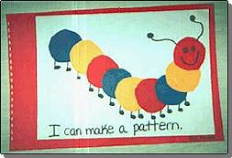
MATHS
We use the white rose scheme which has a range of lovely activities & introduces the children to lots of Mathematical vocabulary
*Counting
*COUNTING BEYOND 10
*COMPARING NUMBERS
*One MORE THAN/ ONE LESS THAN
*RECALLING NUMBER BONDS TO 10
*ACTIVITIES LINKED TO SHAPES
*PATTERNS
*COMPARING LENGTH, WEIGHT & CAPACITY

Slide 13

NUMBER
*NUMBER BONDS UP TO 5 THEN Up To 10
*DOUBLE FACTS
NUMERICAL PATTERNS
*VERBALLY COUNT BEYOND 20
*COMPARING QUANTITIES UP TO 10-RECOGNISING WHEN ONE QUANTITY IS GREATER THAN, LESS THAN OR THE SAME AS THE OTHER QUANTITY
*KNOW EVENS & ODDS, DOUBLE FACTS & HOW QUANTITIES CAN BE DISTRIBUTED EQUALLY

Slide 14
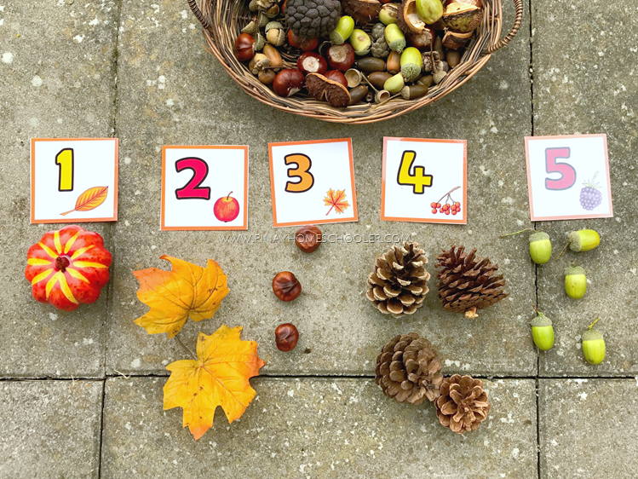
SUPPORTING MATHS AT HOME
*Recognising numbers-Games, JiGsaws
*Counting favourite toys/ teddies/ Real objects etc
*Playing maths games
*Interactive games on the computer or ipad
*Forming numbers
*Measuring out ingredients when cooking

Slide 15
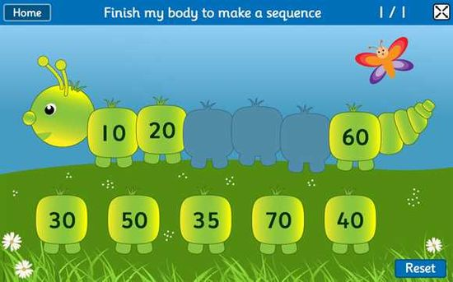
SAPPHIRE PAGE ON THE SCHOOL WEBSITE & USEFUL Websites
*Phonics Sheets added each term
*Links to useful learning websites & Handwriting powerpoint
*Mini mash
*Reading Eggs
*Topmarks learning games

Slide 16

ONLINE SAFETY
*Covered within lessons/Assemblies using child friendly stories & Resources
*Learn about keeping safe on the computer/ Ipad
*Refer to online safety poster

Slide 17
Working together/ Supporting parents
*Miss Foley will be at the gate each morning Or Catch at the end of the day
*Yellow reading record book
*Class email sapphireclass@richarddurnings.lancs.sch.uk
*Parents evening
*Family Morning/ Afternoon
*Recommended reads on class Sapphire page
*Curriculum information on school website

Slide 18
THANK YOU FOR COMING TO THE MEETING
ANY QUESTIONS

